Slide 1
Version Control with Git and GitHub
By Innocent Suta

Slide 2
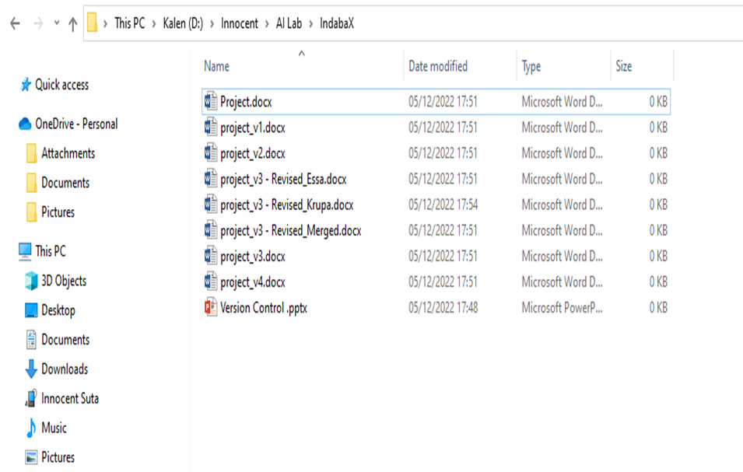
What is version control?
Version control allows you to keep track of your work and helps you to easily explore the changes you have made, be it data, codes, notes etc.
Challenges of working on a project
Undo and Redo
Tracking changes
Working with others
Sharing Changes
Overlapping work when working in a team

Slide 3
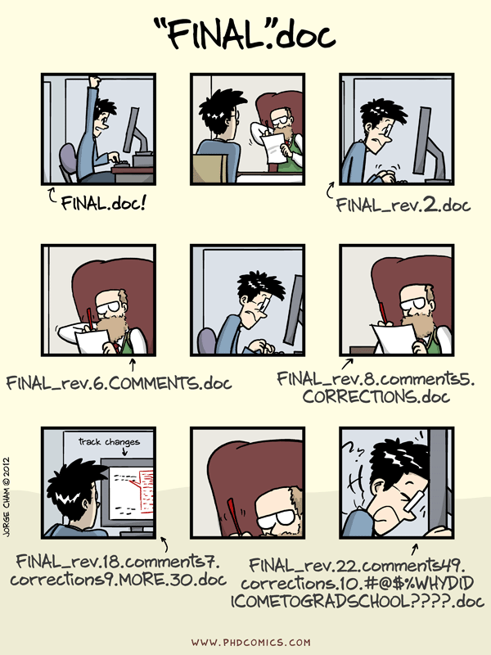

Slide 4
Why use version control?
History of changes – Each file in the local or remote repository has a history making it easy to explore the changes that occurred to it at different time points
No worries about breaking things that work - revert to the previous version
Merging changes from multiple people
Review other people’s code, add comments to certain lines or the overall document and suggest changes.
Version control allows you to keep track of your work and easily navigate among the many versions of the files you create, whilst also maintaining an online backup (Github, Bitbucket etc)

Slide 5
What is git?
Distributed version control system.
Developed by Linus Torvalds (developer of Linux) in 2005.
used to manage the source code for Linux
Track any content.
Source code
data analysis projects
Manuscripts
Websites
Git makes version control much smoother and easier to implement.

Slide 6
Why use git?
It’s fast - Applying updates should not take longer than 3 seconds
You don’t need access to a server
Support distributed system workflow
Amazingly good at merging simultaneous changes
Take the Concurrent Version System - (free and Paid software)

Slide 7
Git main features
Track all your changes
Work along with others
Share work with others

Slide 8
What’s Github
.
Bitbucket.org is an alternative – Free private repositories

Slide 9
Why use github ?
Having a GitHub repo makes it easy for you to keep track of collaborative and personal projects
GitHub allows you to assign tasks to different users, making it clear who is responsible for which part of the analysis, feature of the project or code
Graphical user interface for git
Exploring code and its history
Tracking issues
Facilitates:
Learning from others
Seeing what people are up to
Contributing to others’ code

Slide 10
Git terminology
Repository - container for snapshots and history
Remote - connection to another repository for example GitHub (like URL)
Commit –
A snapshot, a basic unit of history
A full copy of a project
Includes author, time, comments, pointer to the parent
Reference - a pointer to commit
Branch - a separate line of workflow
Merge - a commit that combines 2 lines of history (points to 2 paren

Slide 11
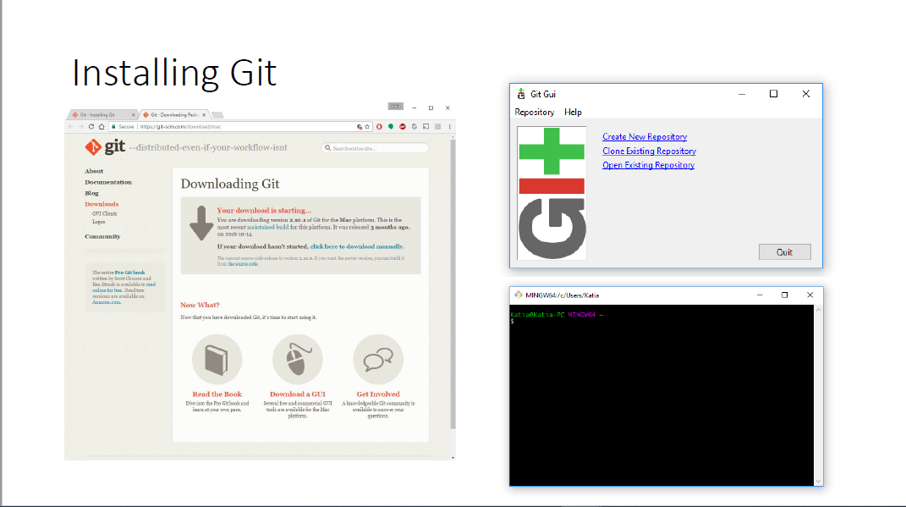
Git installation

Slide 12
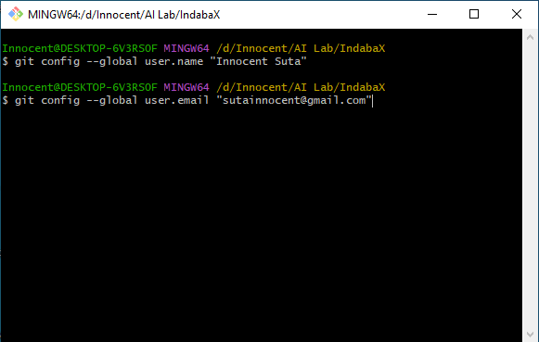
Git : basic configuration

Slide 13
Github : set up repository
Get a GitHub account
Click the “Create a new repo”
Give it a name and description
Click the “Create repository” button

Slide 14
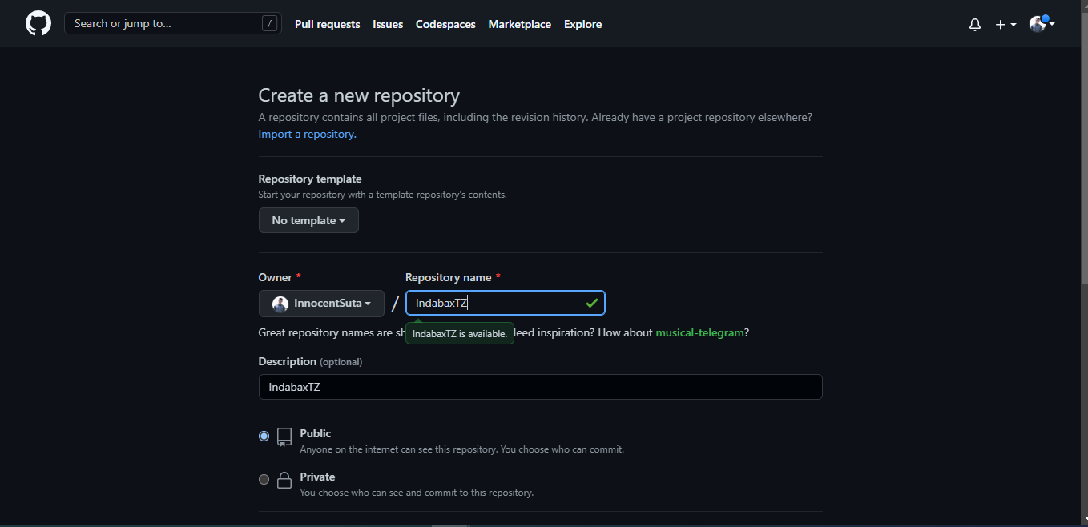
Github : set up repository

Slide 15
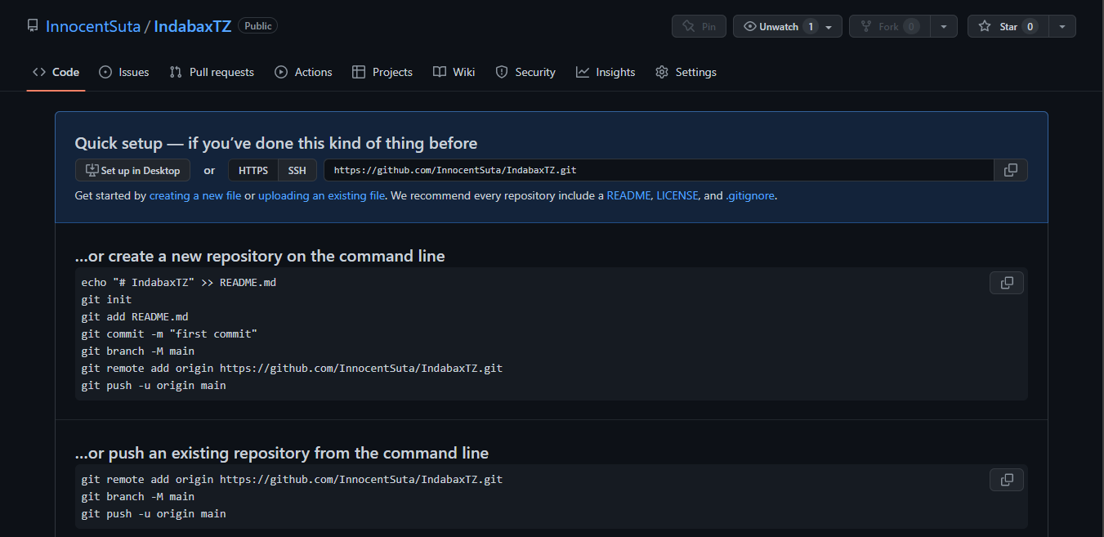
Github : Set up repository

Slide 16
Pushing your project on github

Slide 17
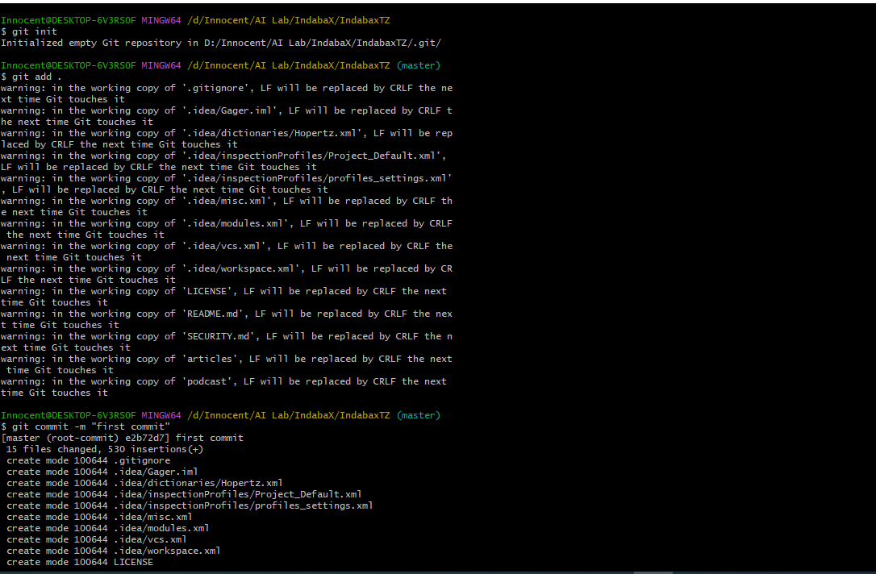
Initialize repository
Create (and cd to) a working directory
E.g, ~/IndabaX/IndabaxTZ
Initialize it to be a git repository
git init
Incorporate into repository
Stage the changes using git add
Now commit using git commit
The -m argument allows one to enter a message
Use a meaningful message
Message can have multiple lines, but make 1st line an overview

Slide 18
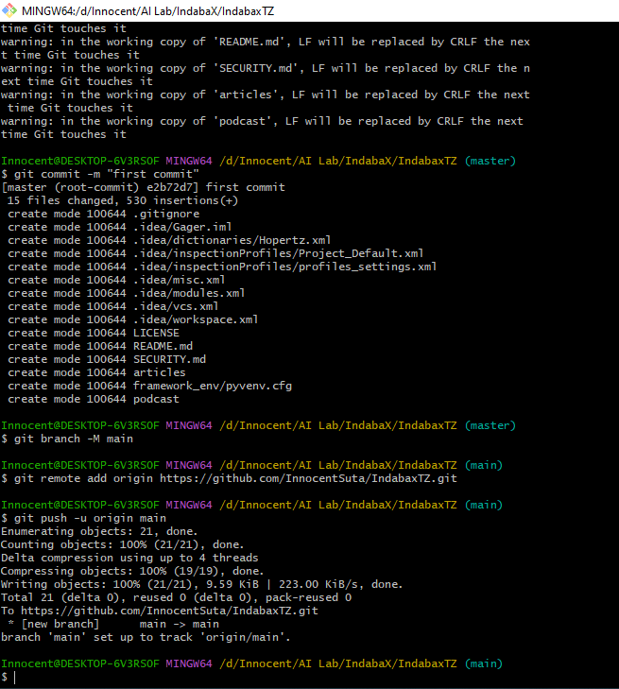
Use git status to check if you’re missing anything.
Push to the branch that you’re working on.
Set up .gitignore file

Slide 19
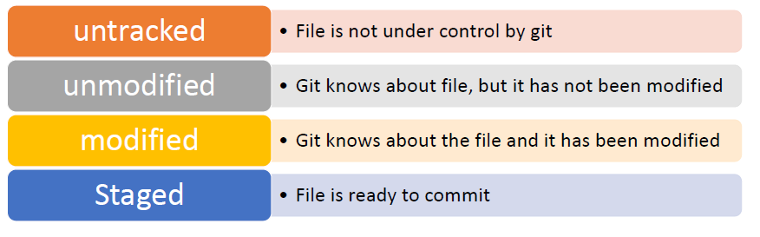
Git : STATUS

Slide 20
Removing/moving files
Use the following for all files that are tracked by git.
Use git rm instead of just rm
Use git mv instead of just mv

Slide 21
Destroy it and start over
Why?
You commit something you shouldn’t have (large and/or private)
You are embarrassed by your repository’s history
You can’t figure out the mess you’ve made
Pick the repository you like and destroy the other one
For example, get your local directory in the state you like and destroy everything else
Local repository
If you delete the .git subdirectory, it’ll no longer be a git repository
GitHub repository
Go to the settings for the repository and head down to the Danger Zone

Slide 22
Branching and Merging
Use branches to test out new features without breaking the working code.
git branch develop
git branch
git checkout develop
When you’re happy with the work, merge it back into your master branch.
git checkout master
git merge develop

Slide 23
Issues and Pull requests
Problem with or suggestion for someone’s code?
Point it out as an Issue
Provide a fix or better solution or suggesting a change to an existing repo
Fork the repository
Clone your version of it – git clone https://github.com/InnocentSuta/IndabaxTZ
Modify / change things locally - git add
Commit changes – git commit
Push to your repository - git push
Submit a Pull Request - “Pull Requests” and “New pull request”

Slide 24
Summary

Slide 25
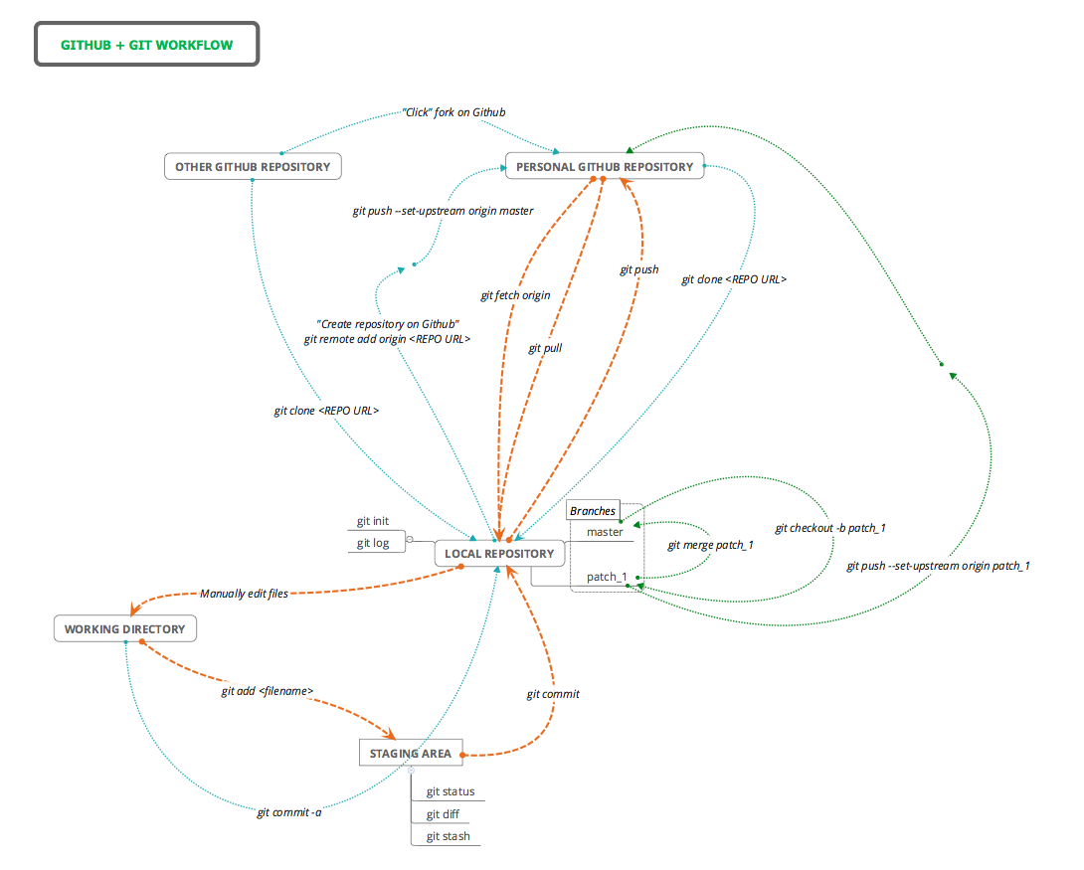

Slide 26
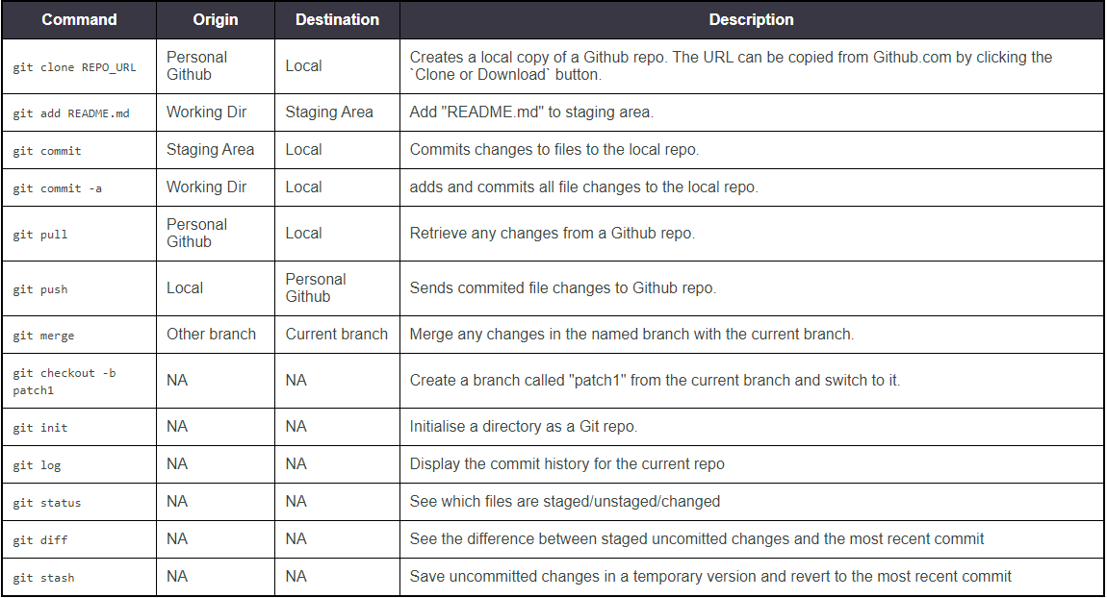

Slide 27
Thank you ☺

